Slide 1


Key Factors Influencing Corporate Workplace Stress
Gender
Does gender bias contribute to stress?
Personal Support
Does family help reduce stress? Does sleep or exercise reduce stress?
How You Work
Does working remotely or working with a smaller team size contribute to stress?

Slide 2
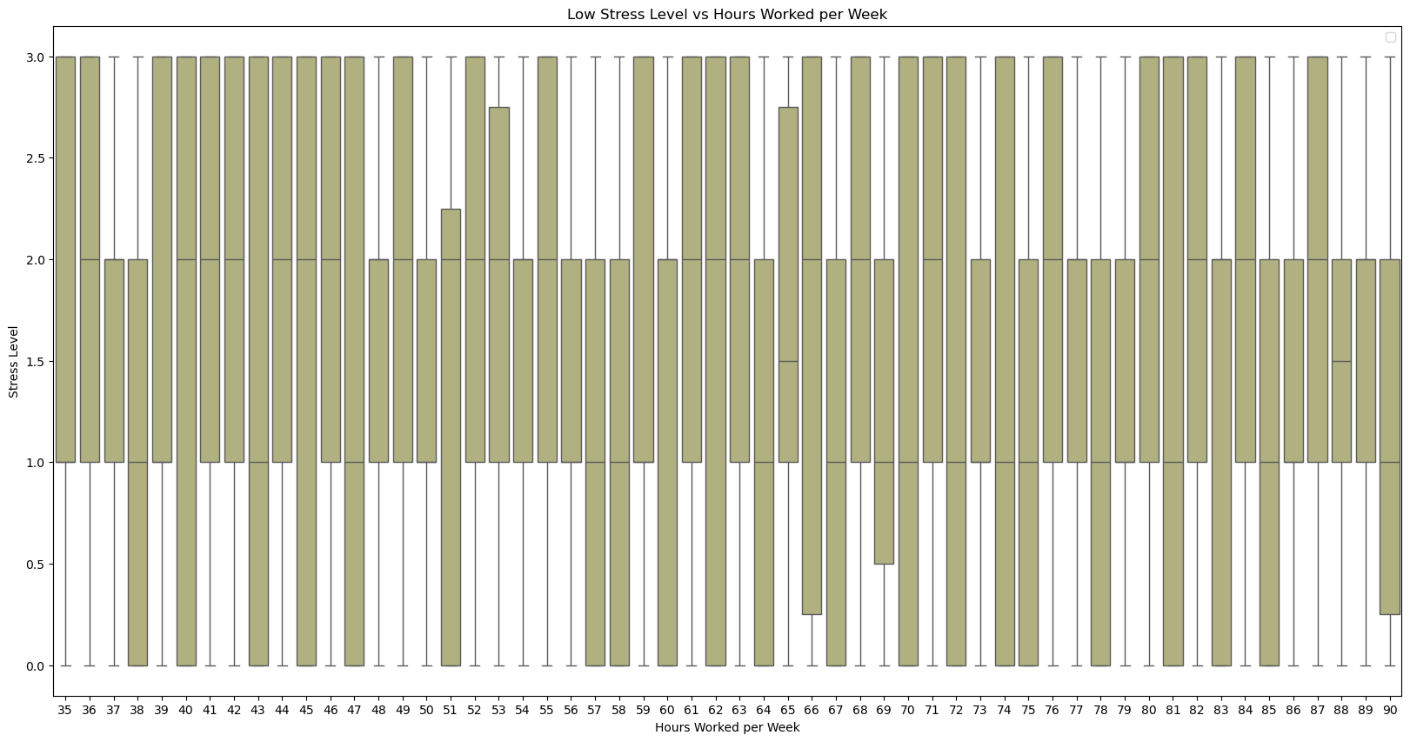
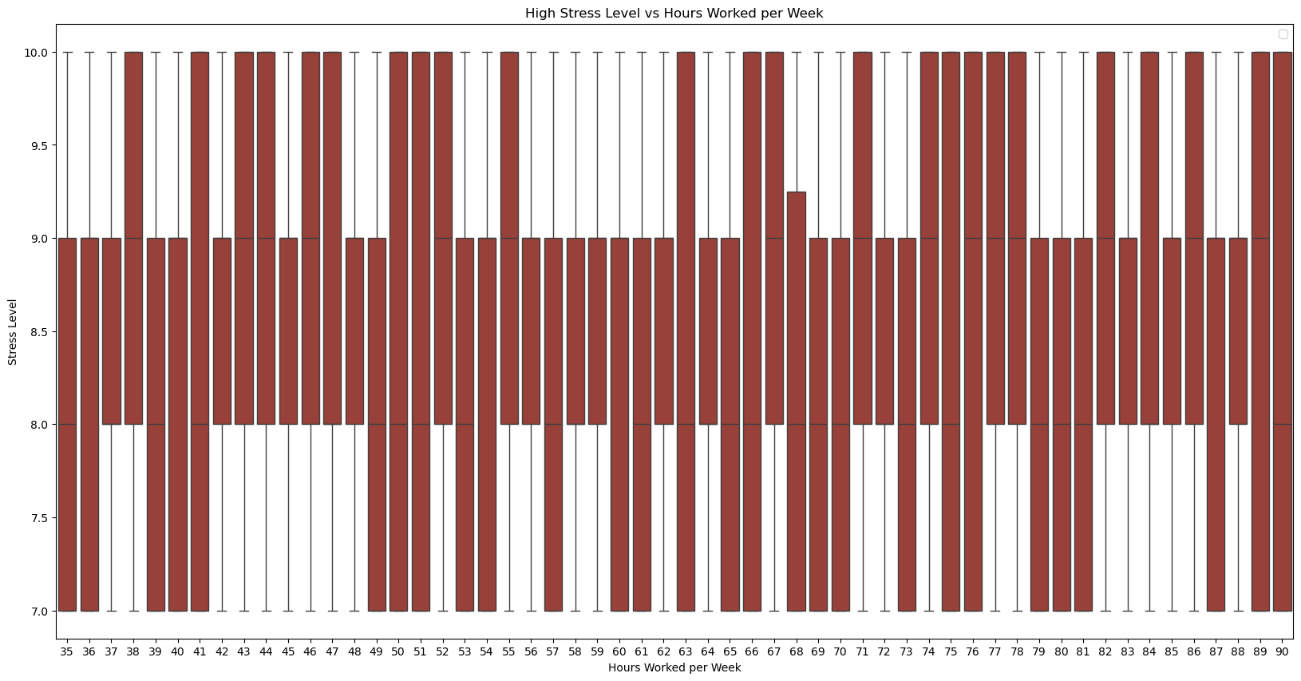
Low Stress Versus High Stress Reactions to Working Hours per Week
Based on these Visualizations, there is an even distribution of the two extremes: Low and High Stress.
Low Stress : 0 – 3: There is no definitive difference between more hours that were worked and lower stress levels, which is unusual.
High Stress : 8 -10: With a similar distribution of stress levels as the low stress individuals, there can be no judgement made on whether more hours worked correlates to higher stress levels.

Slide 3
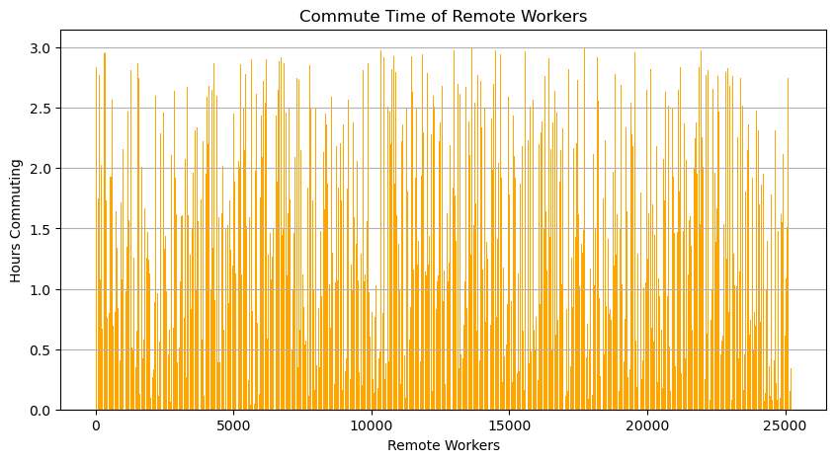
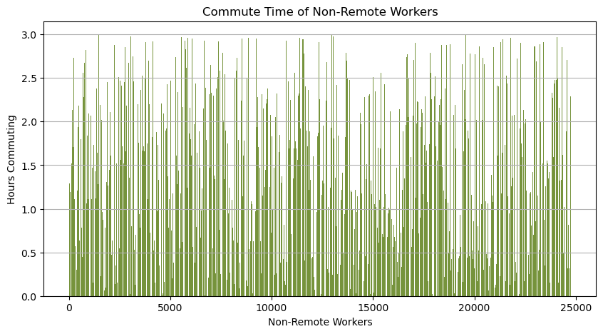
Commute time of Remote Workers and Non-Remote Workers
During our analysis concluding that the data set is not conclusive, we started searching for logical plot holes within the data. The biggest example was: Why do remote workers have commute times?
Facts to consider:
Remote workers make up 25234 individuals of our data set
Non- Remote workers make up 24766 individuals of our data set
In addition, why do we have an almost equal split of remote and non-remote workers?

Slide 4
All Possible Factors that Could Lead to Stress
Within this heat map, we can see all possible factors that could have contributed to our analysis. Every option is incredibly slim, with the greatest effect being Work Pressure Level at 0.008 degrees compared to the stress levels.

Slide 5
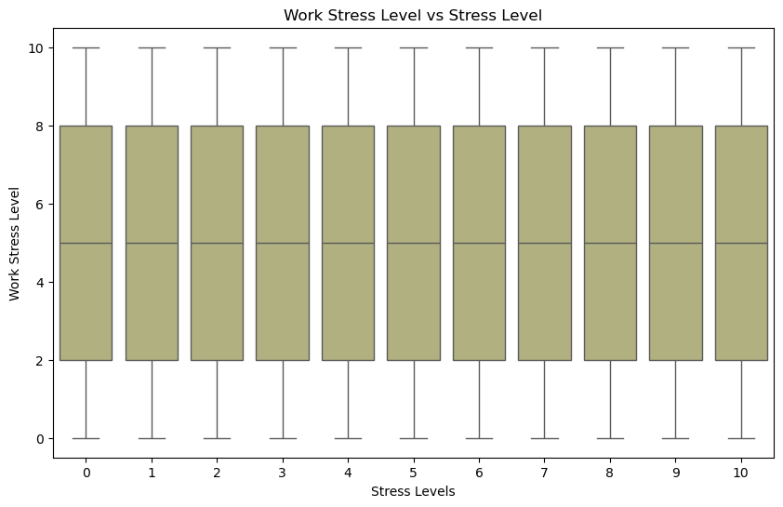
Work Stress Levels
Even with the highest correlation connection of 0.008 degrees to the overall stress levels of our individuals, there is still no difference in the breakdown to make an inference of a conclusion.

Slide 6
Conclusion
During the start of this project, we were hopeful and optimistic about our hypotheses being correct. What we didn’t expect was to find that our data set was not truthful or legitimate. The only logical conclusion to our question of “What Factors Contribute the Most to Stress?” is, according to this data set, none. No conclusions can be made.

